Slide 1
An Exploratory Data Analysis on Food Desert in the USA
DATAS6101 – Intro to Data Science Project
Source: ers.usda.gov
Abishek Chiffon | Keerthana Aravindhan | Mowzli Sre Mohan Dass | Robert Williams

Slide 2
Food Desert
A food desert is a geographic area, typically in urban or rural regions, where residents have limited access to affordable and nutritious food. In these areas, there is often an absence of grocery stores, supermarkets, or other sources of fresh and healthy food options
A Tract area considered to collect the census data

Slide 3



Food Desert

Slide 4

Tract area
½ mile for Urban 10 mile for Rural
Tract area
1 mile for Urban 10 mile for Rural
Tract area
1 mile for Urban 20 mile for Rural

Slide 5
Q1. Geographic Distribution of Food Deserts
A total of 51 States and 3,140 Counties are represented in the Dataset
Overall, 72,857 Rows of data has been included in the analysis

Slide 6
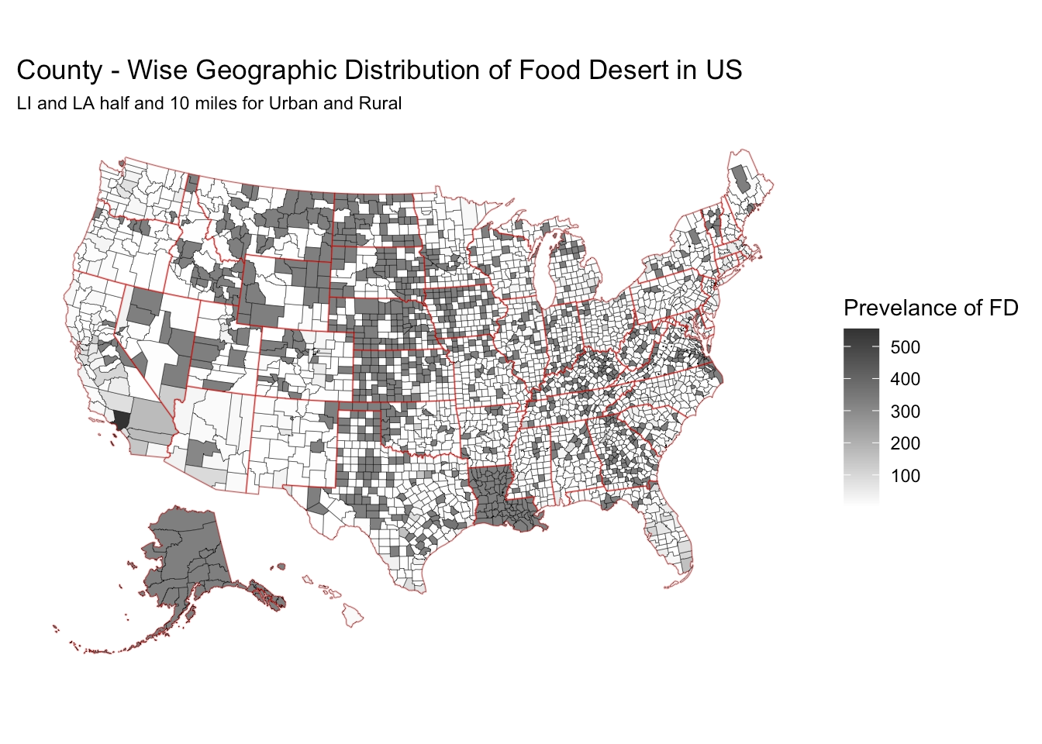
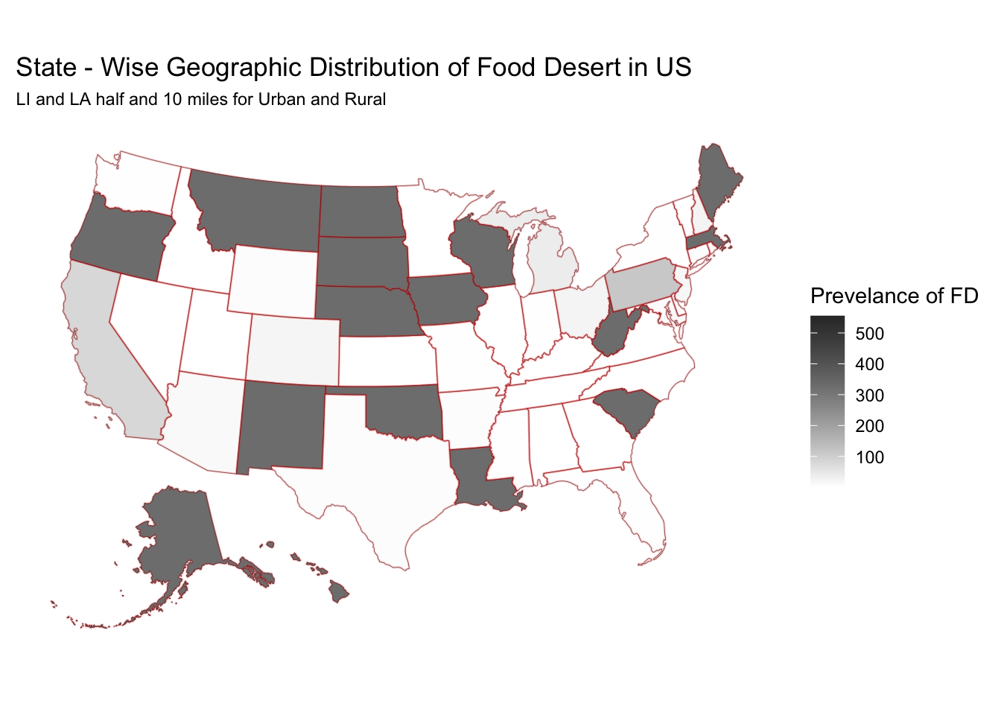
Q1. Geographic Distribution of Food Deserts

Slide 7
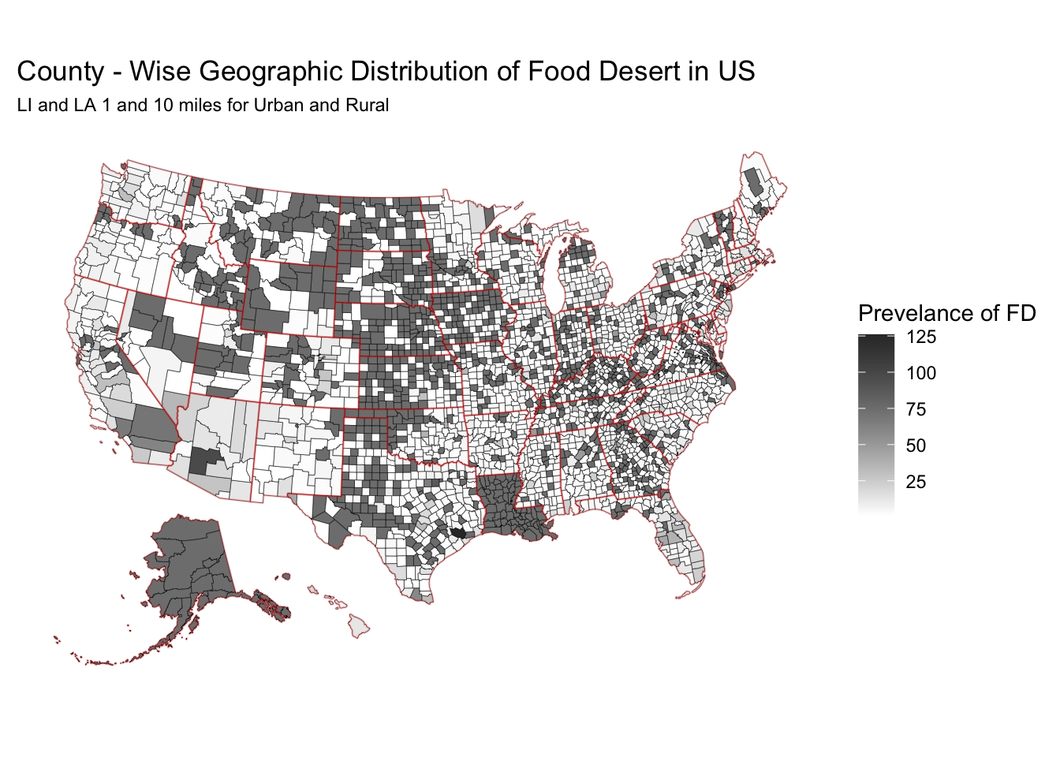
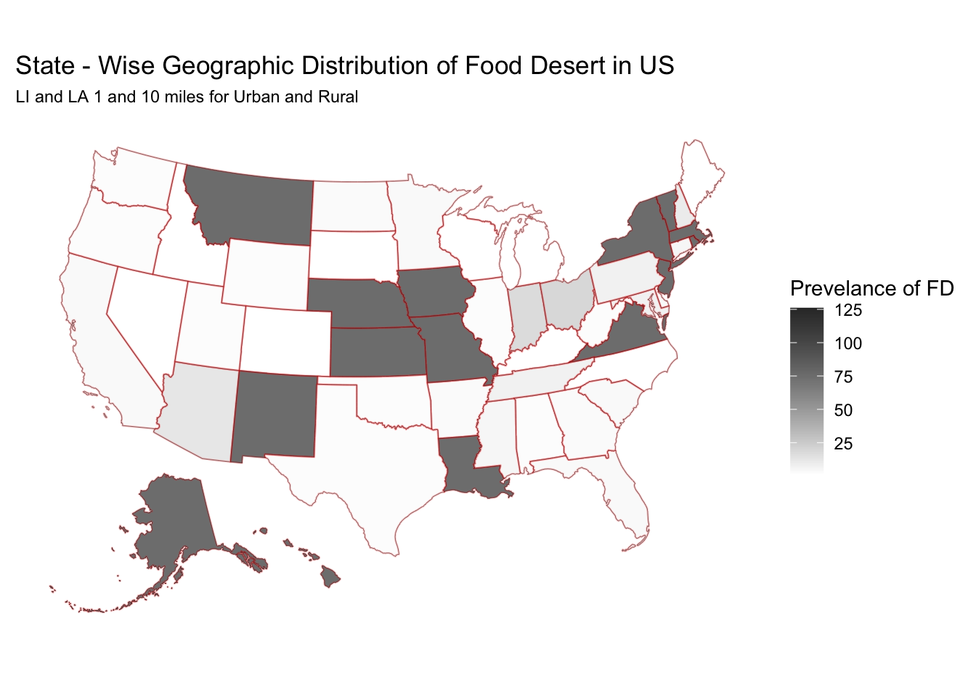
Q1. Geographic Distribution of Food Deserts

Slide 8
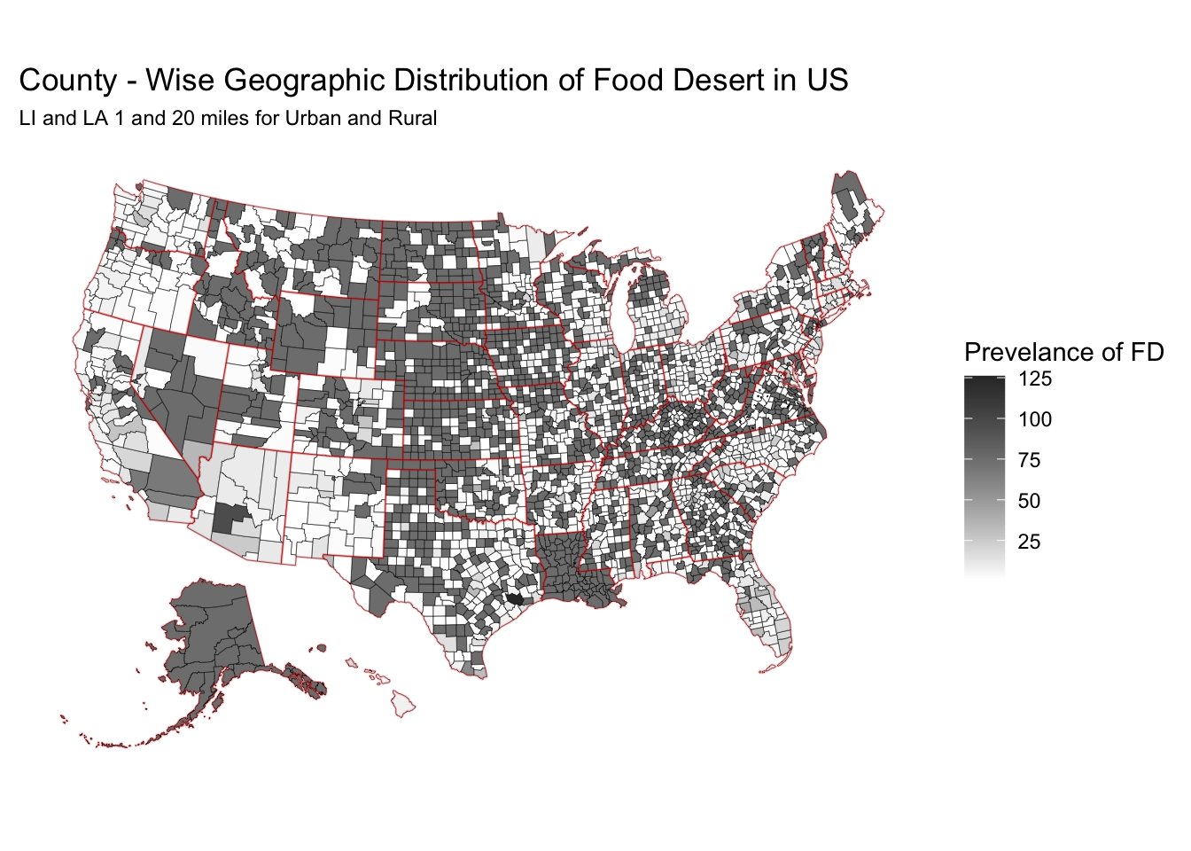
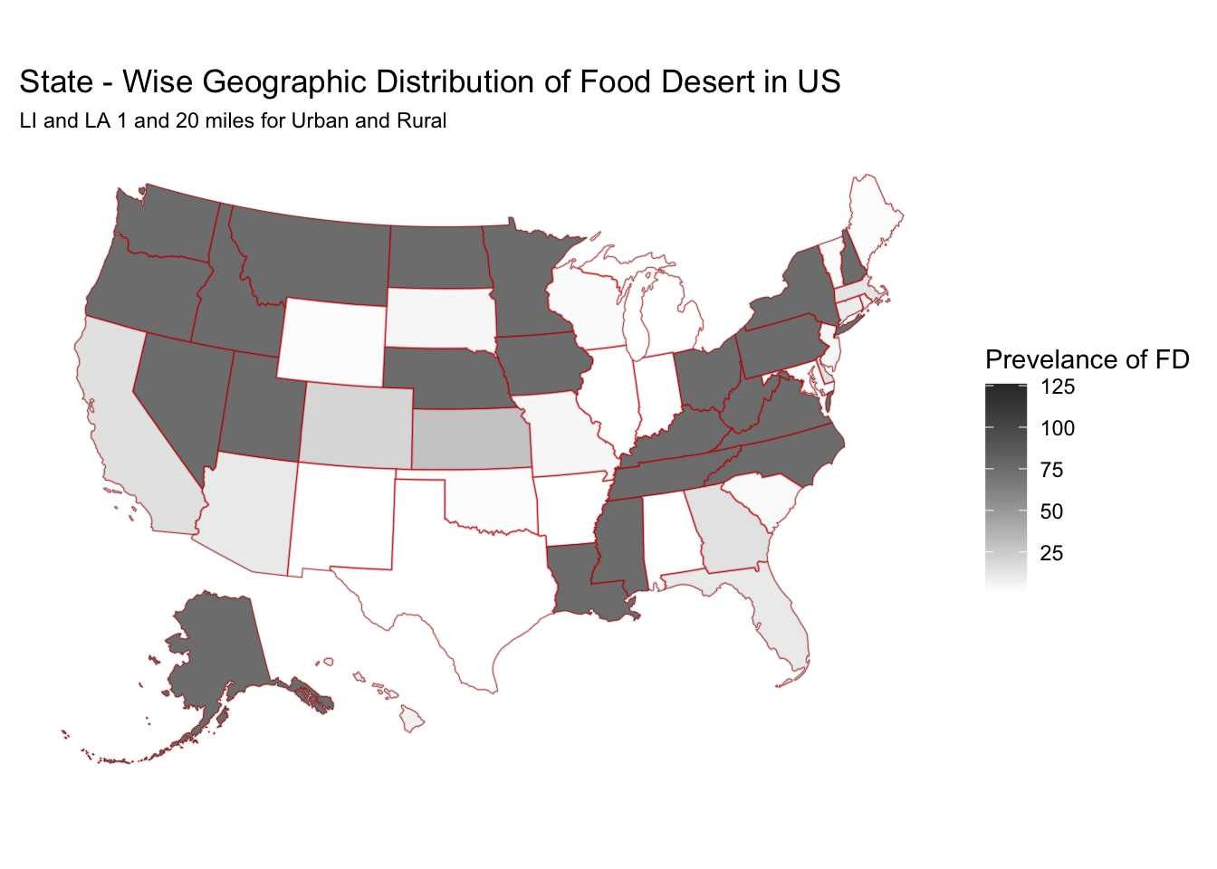
Q1. Geographic Distribution of Food Deserts

Slide 9
Q2. Urban vs Rural Classification impacts

Slide 10
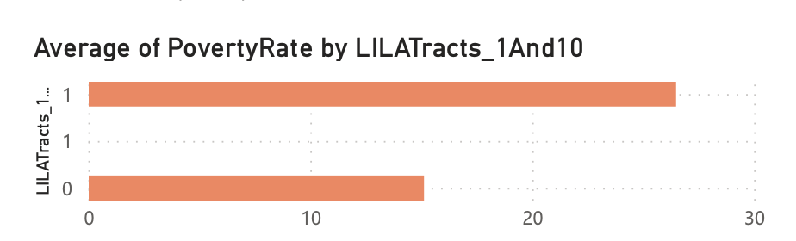
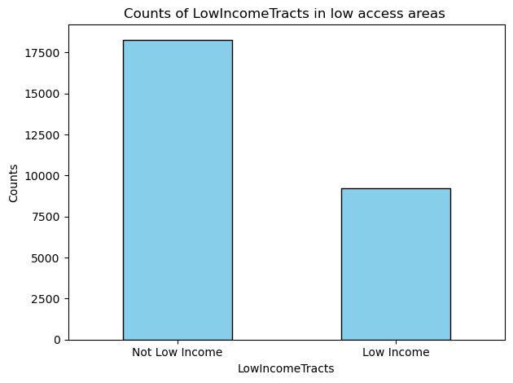
Correlation between poverty rate and Food desert.
• Poverty rate is high in food deserted areas
• In food deserts , poverty rate is 75% higher than non-food deserts
* 66% of the non-low income tracts are low access tracts
* Low access people are rich which may mean rich people wants to stay outside.

Slide 11
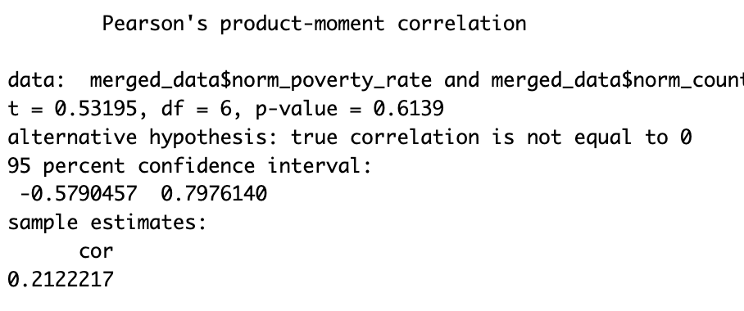
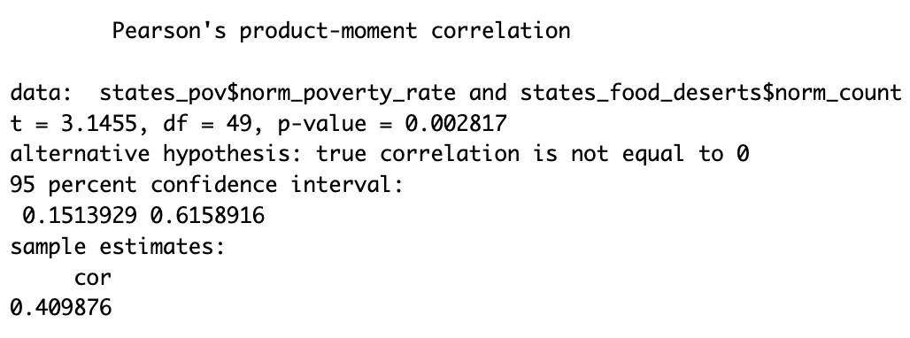
Correlation between poverty rate and Food deserts
No linear Correlation between High poverty rate states with count of their food desert
Correlation between poverty rate of all states with count of their food desert.

Slide 12
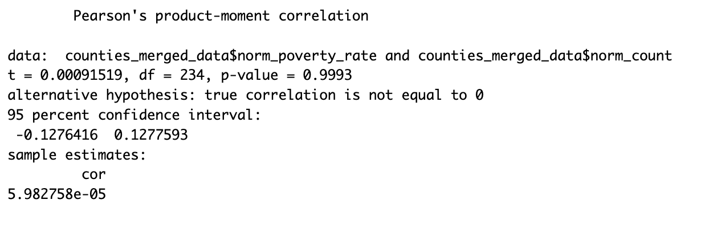
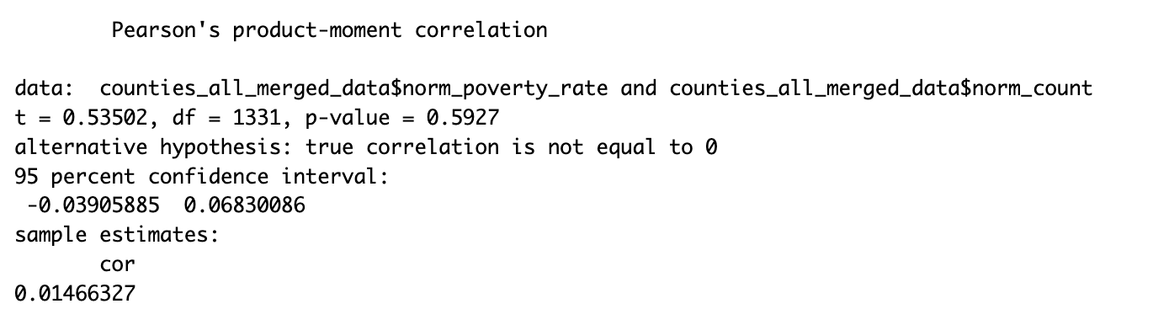
Correlation between poverty rate of counties and Food deserts
No linear Correlation between poverty rate of counties with count of their food desert

Slide 13
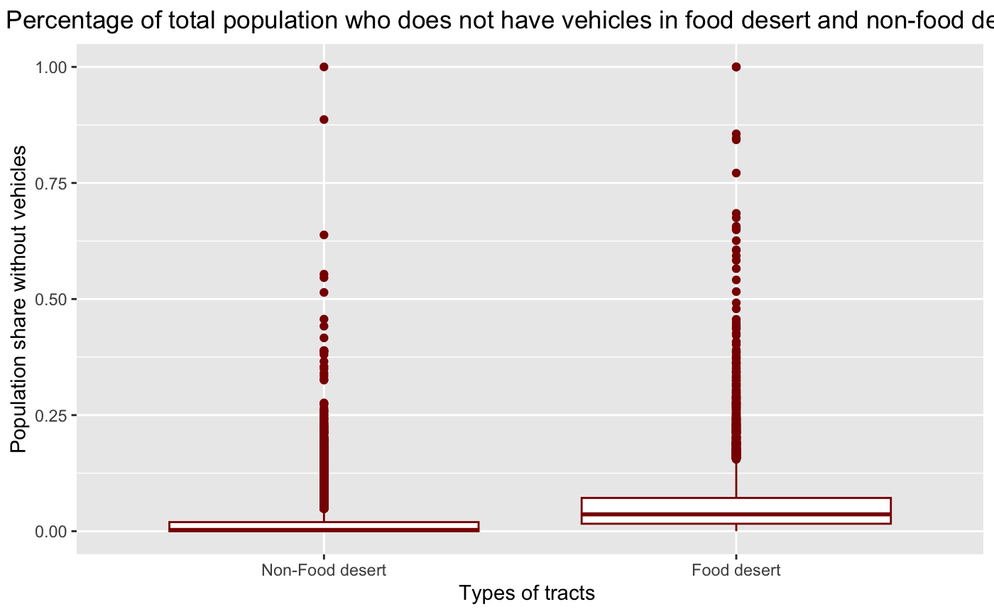
The impact of vehicle availability on food desert designation?
A higher percentage of the population in food deserts lack vehicles compared to those in non-food
This could be concerning, as people in food deserts without vehicles may have even more difficulty accessing fresh and healthy food.

Slide 14
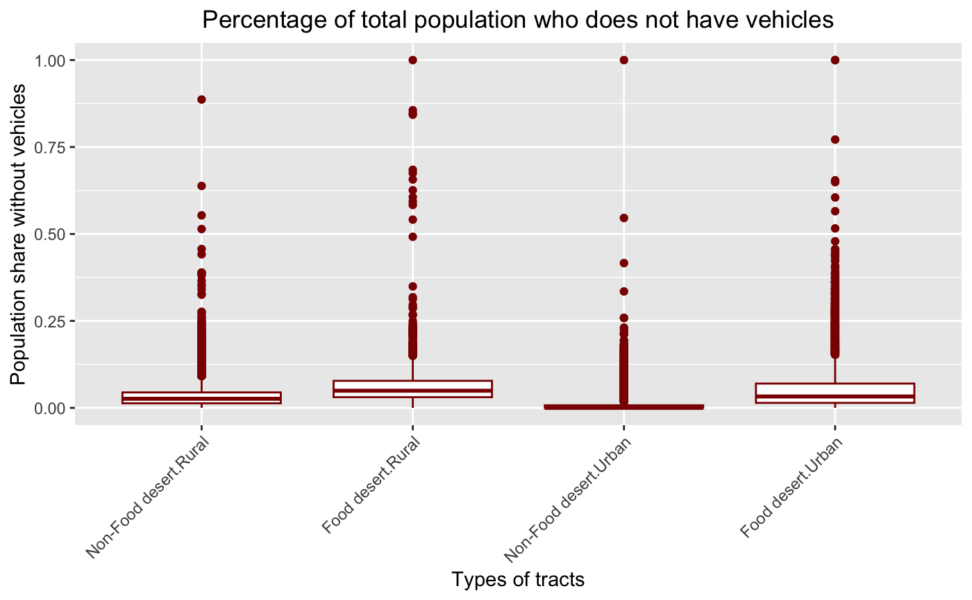
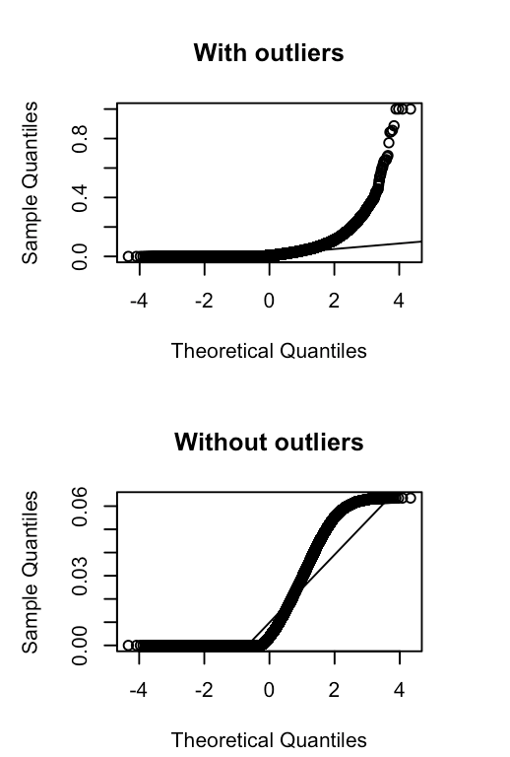
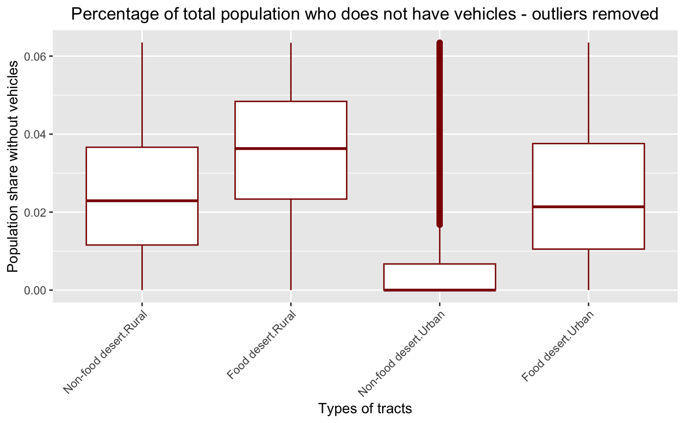
Vehicle access in rural and urban tracts
Food desert Rural areas - low vehicle access,
Non – food desert Urban Areas – Highest vehicle access as expected.

Slide 15
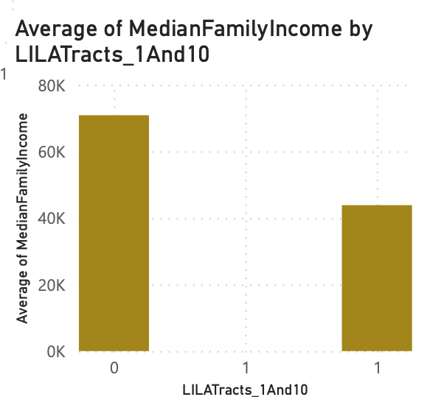
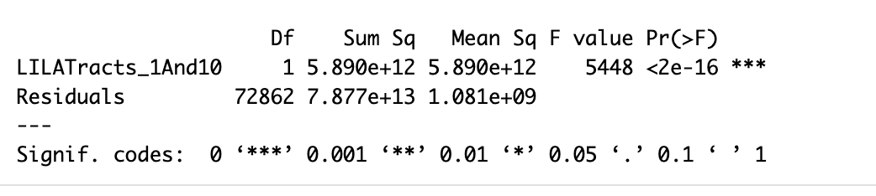
FOOD desert and Median Family Income
Anova on Median Family Income
The p-value 2e-16 is less than the 0.05
Reject the Null hypothesis
The Anova results tell us that there is statistically significant difference in median income among food desert and non - deserts

Slide 16
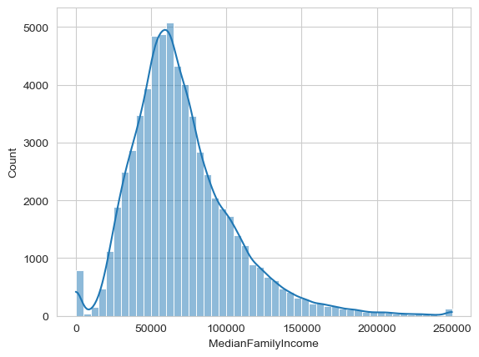
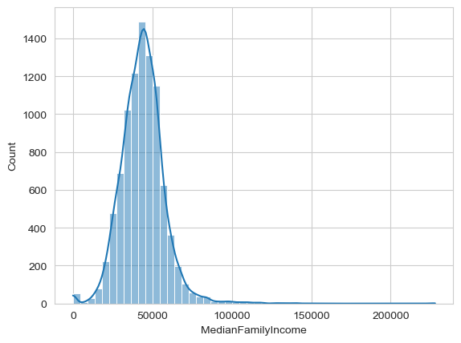
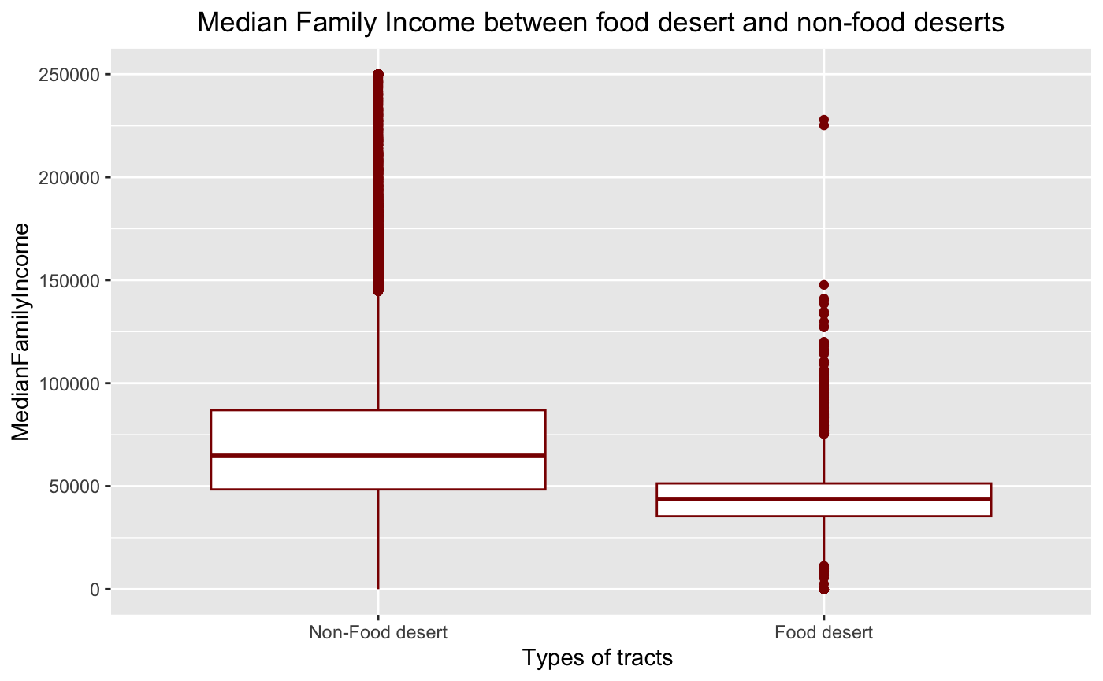
Relationship between Income variables (MedianFamilyIncome, LowIncomeTracts) and food deserts?
Median Family Income In Non-Food desert tracts
Median Family Income In
Food desert tracts
95th level Confidence interval of mean for Food deserts
[43566.32 44127.11]
Mean estimate - 43846.72
95th level Confidence interval of mean for non- Food deserts
[70588.70 71129.46]
Mean estimate - 70859.08
Food desert – Low Income
Non-Food desert - High Income

Slide 17
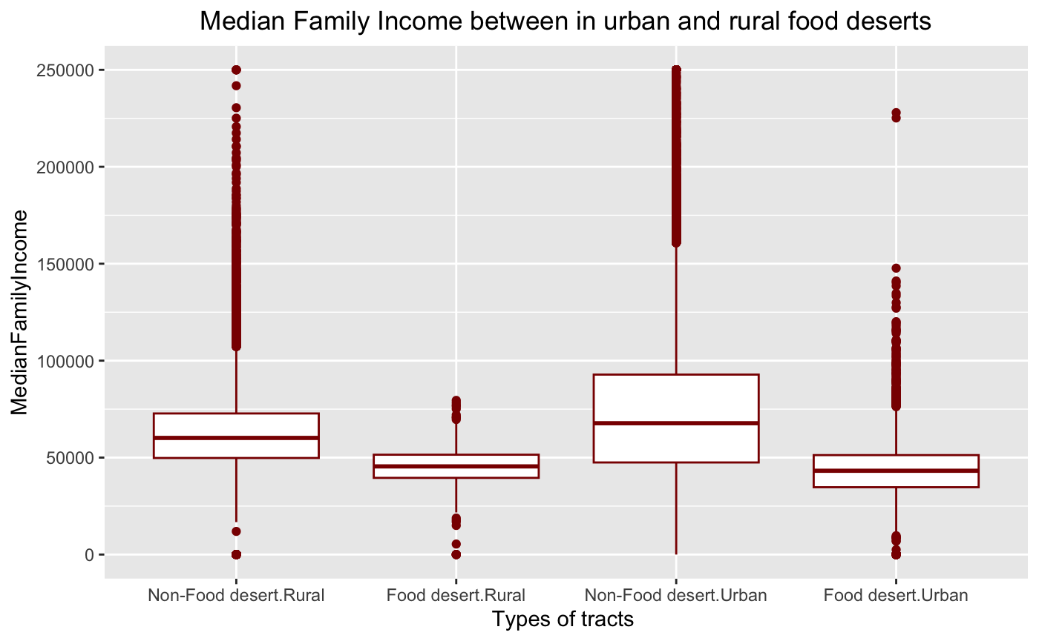
Median Family Income between a combination of food desert and Urban tracts
The median family incomes in urban is almost similar to Rural.
This suggest food desert in rural areas is not solely due to economic reasons.
And non-food deserts in urban have higher median income than others.

Slide 18
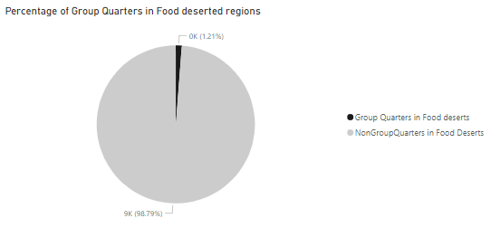
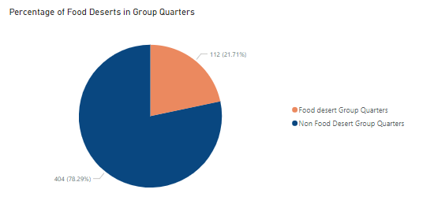
Characteristics of Areas with Group Quarters:
Group Quarters are very less in Food deserted regions.
Also, Percentage of Food deserts in Group Quarters are less compared to Non Food deserts.

Slide 19
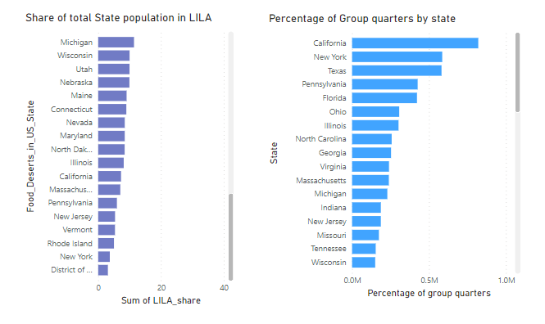
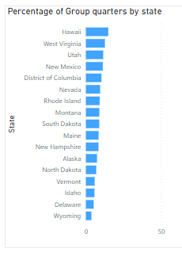
Percentage of Group Quarters tracts by States:
California and New york have highest group quarters tracts.
Wyoming and Delaware have least group quarters tracts.

Slide 20
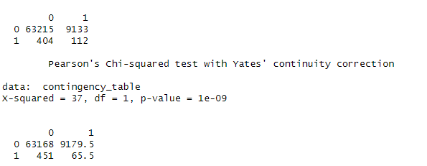
Correlation between the percentage of Group quarters and the prevalence of Food deserts
Chi-square (GOF) between GroupQuartersFlag and LILATracts_1And10:
Null Hypothesis (H0): there is no association between the two categorical variables.
Alternative Hypothesis (H1): there is an association between the two categorical variables.
Significance level alpha = 0.05
Conclusion:
low p-value - reject the null hypothesis
thus there is a significant association or correlation between "GroupQuartersFlag" and "LILATracts_1And10."

Slide 21
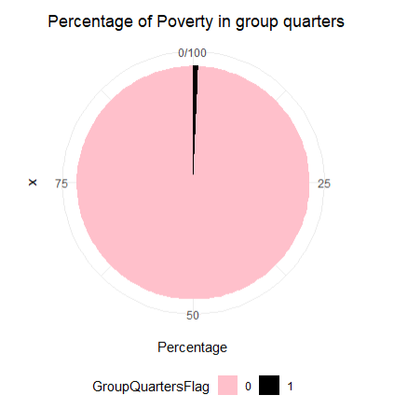
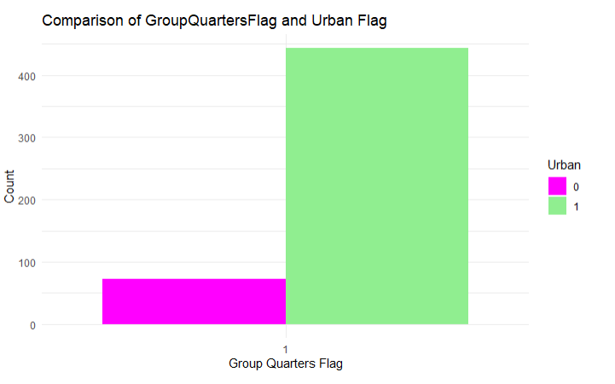
Characteristics of Areas with Group Quarters:
Group quarters are more in urban compared to Rural.
Poverty rate is more in Non Group Quarters tracts.

Slide 22
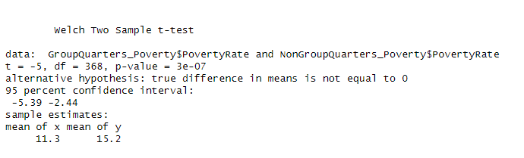
T-Test to compare the "Poverty Rate" between tracts with and without Group quarters:
Null Hypothesis (H0): The average Poverty rate are the same for with and without group quarters
Alternative Hypothesis (H1): The average Poverty rate are different for with and without group quarters .
Significance level alpha = 0.05
Conclusion :
There is a significant difference between the means.
Mean of Poverty rate is more in Non Group Quarters tracts.

Slide 23
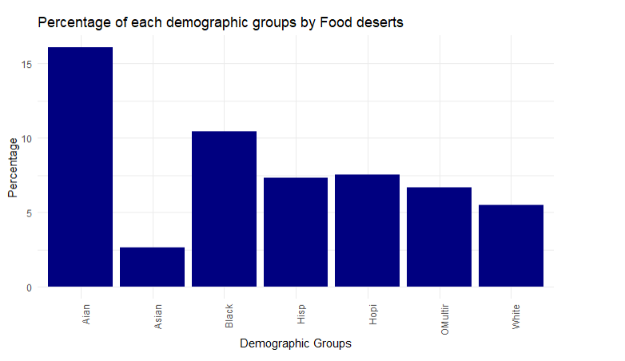
Different Demographic groups in Food Deserted Tracts:
AIAN (American Indian or Alaska Native) and black are more in Food deserted areas compared to other groups.
Least Demographic group in Food deserts - Asian

Slide 24
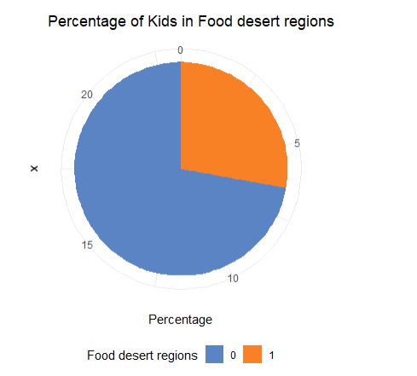
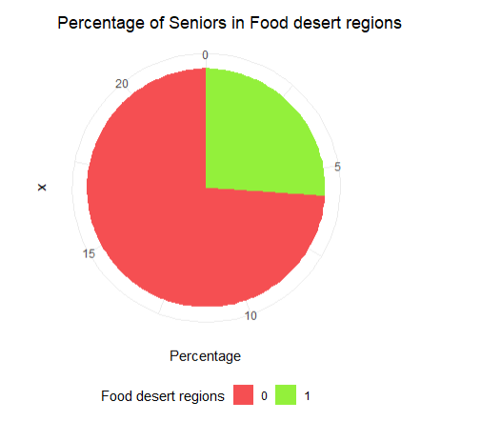
Population of Kids and Seniors in Food and Non Food deserted tracts.
Population of Kids and Seniors are more in Non Food deserted regions.
We can say, they opt for non food deserted tracts.

Slide 25
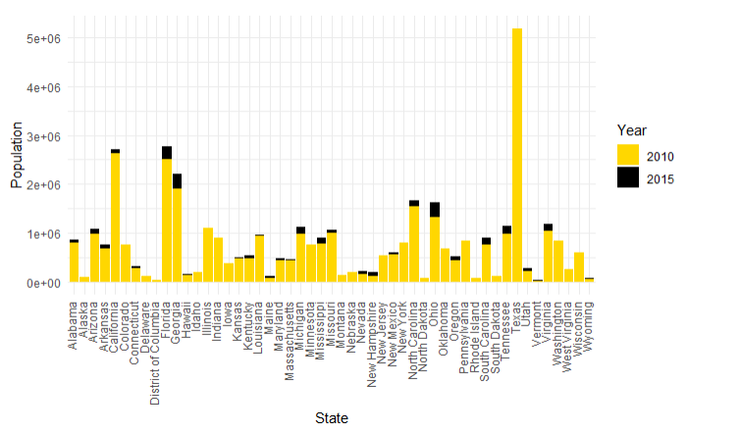
Population change in Food deserts from 2010 to 2015
In 2010, ~ 37 million of US population lived in Food deserted tracts.
In 2015, ~ 39 million of US population lived in Food deserted tracts
Increased by 2M.

Slide 26
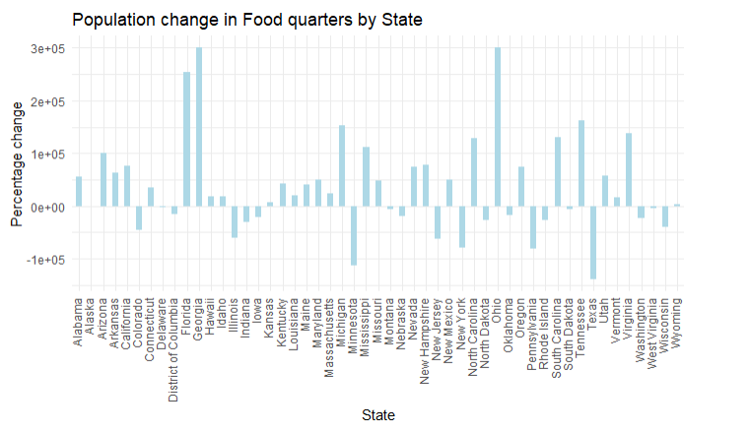
Population change in Food deserts from 2010 to 2015

Slide 27
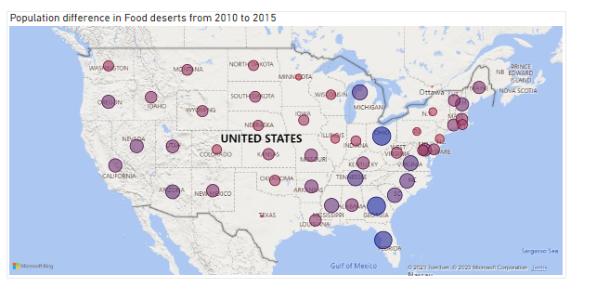
Population change in Food deserts from 2010 to 2015
– High population difference
– low population difference
Eastern side states have major change in Food desert population.

Slide 28
References
Ref 1
Ref 2

Slide 29
Thank You!

